Slide 1
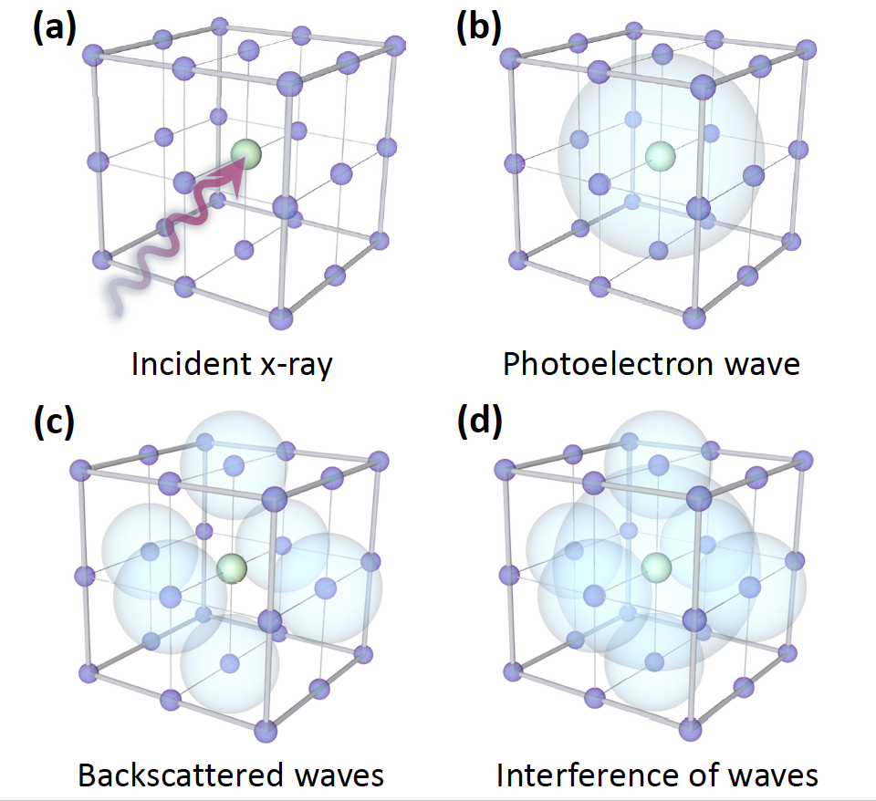
Figure 1
Figure 2

Slide 2
Figure 3
Phase difference: pi/2
Figure 4

